Slide 1
Controlling Electrical Appliances from Internet
Project By:
Lakshadeep Naik(11ECE055)
Agasti Tari(11ECE073)
Pushkar Vengurlekar(11ECE075)

Slide 2
Different Steps Involved in Implementation of Project
Inserting the data in MYSQL database.
Reading the data from MYSQL database
Sending the data read from MYSQL database to Microcontroller
Based on data received by Microcontroller setting the particular pin of Microcontroller ON/OFF.

Slide 3
Our future plans………
To design a software which automatically gives us the detailed report regarding which appliance was on for how much time.
To design a software by which we can set the time for particular appliance to switch ON/OFF automatically.

Slide 4
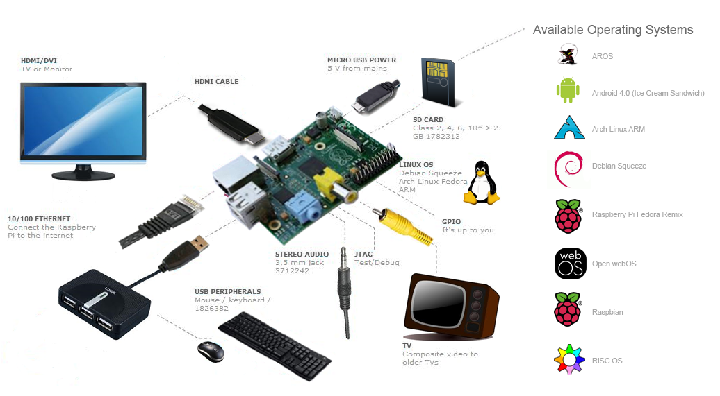
Our future plans….
Implementing the same project using RASPBERRY PI

Slide 5
Our future plans…….
Using some sensor detect if mechanical switch is ON/OFF & to design the system to turn on the appliance even if main switch is OFF.

Slide 6
Want to try this out????????
Go to
http://www.testingnitgoademo2.net84.net/
project/ui.php
And control this appliance from your laptop right now………

Slide 7
Thank You

Slide 8
Different Methods of Inserting Data in MYSQL database
Website
Android Application

Slide 9
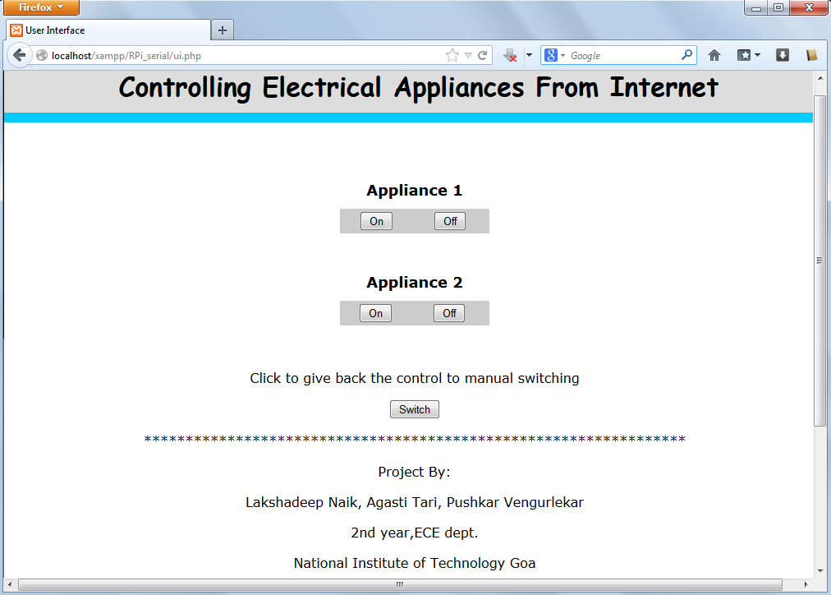
Website

Slide 10
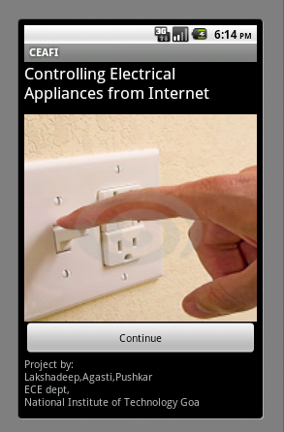
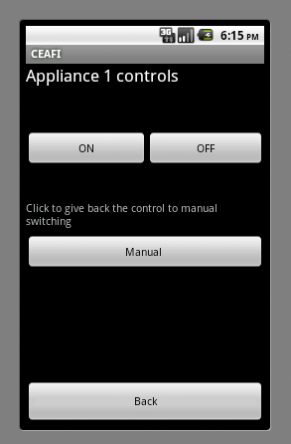
Android Application

Slide 11
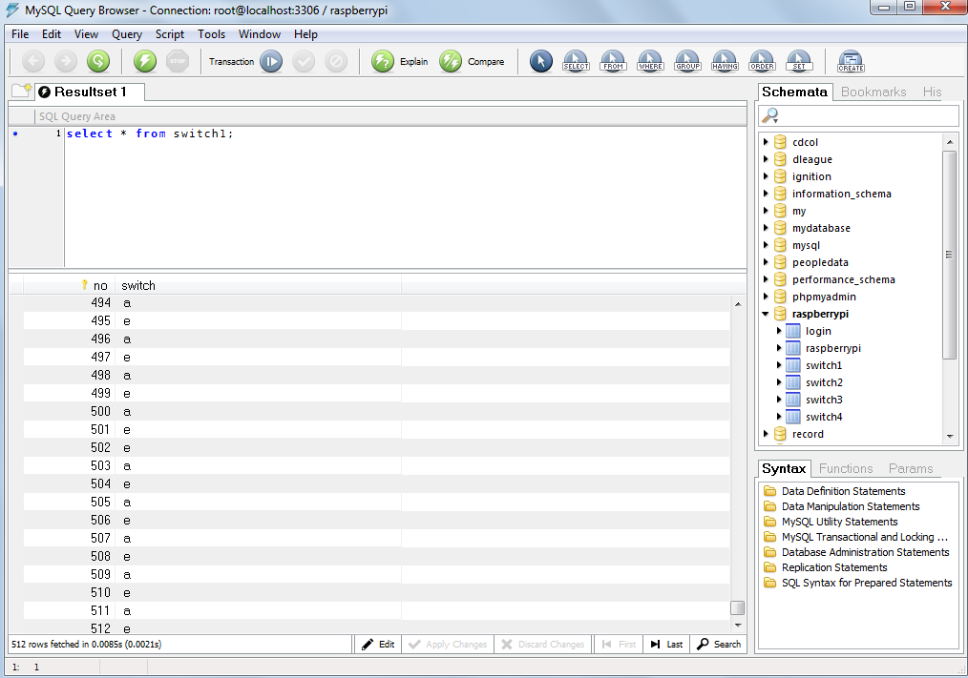
Inserting Data in MYSQL database

Slide 12
Inserting Data in MYSQL database
Separate table is maintained for each and every appliance
Each table consist of 2 columns:
1] Serial Number
2] Data
Demo: Back:

Slide 13
Python Program
It continuously checks data inserted in the last row of the table
Based on data read sends the character to microcontroller using UART serial communication

Slide 14
Python Code
mport serial
import MySQLdb
ser = serial.Serial()
ser.baudrate = 9600
ser.port = 0
a = 0
e = 0
while True:
ser.open()
db = MySQLdb.connect("localhost","root","","raspberrypi")
cursor = db.cursor()
cursor.execute("select switch from switch1 order by no desc limit 1")
data1 = cursor.fetchone()
print data1
if data1 == ('a',):
if a == 0:
ser.write('a')
a = 1
e = 0
elif data1 == ('e',):
if e == 0:
ser.write('e')
e = 1
a = 0
ser.close()
db.close() BACK

Slide 15
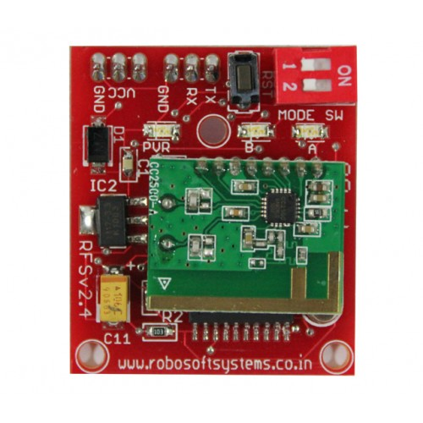
Sending the data from PC to Microcontroller
This is achieved by using UART serial communication.
Data read from the database is send to the COM port of the computer to which CC2500 RF module is connected.
CC2500 transmits the data at radio frequency which is then received by receiver connected at microcontroller.
BACK

Slide 16
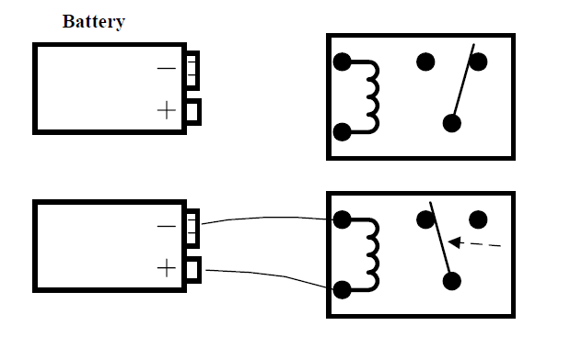
Step 4
Here based on data received by microcontroller PORT of microcontroller to which relay is connected is set ON/OFF
BACK

